Slide 1


基N-快速傅里叶变换
实验成员：胡中林 周海裕 张元胤 闵正铖

Slide 2

目录
1
实验背景
2
实验原理
3
代码实现
4
效果评估

Slide 3
实验背景
01

Slide 4
PART1 实验背景
Experimental background
选题背景：
数据集的指数增长
快速算法的需求
更低复杂度的可能性
实验环境：
MATLAB 2017a
Github协作

Slide 5
实验原理
02

Slide 6
PART1 实验背景
Experimental background
Lemon drops oat cake oat cake sugar plum. Jelly beans macaroon I love topping danish cake
Lemon drops oat cake oat cake sugar plum. Jelly beans macaroon I love topping danish cake
Lemon drops oat cake oat cake sugar plum. Jelly beans macaroon I love topping danish cake
Lemon drops oat cake oat cake sugar plum. Jelly beans macaroon I love topping danish cake

Slide 7
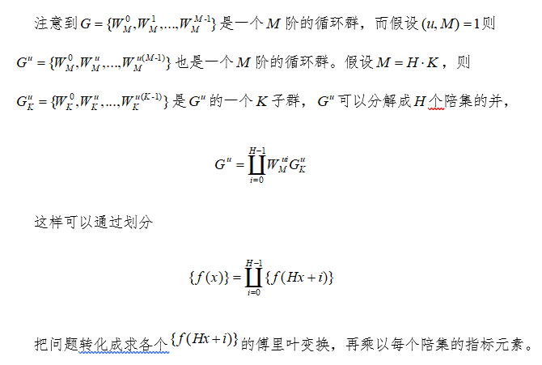
PART2 实验原理
Experimental principle

Slide 8
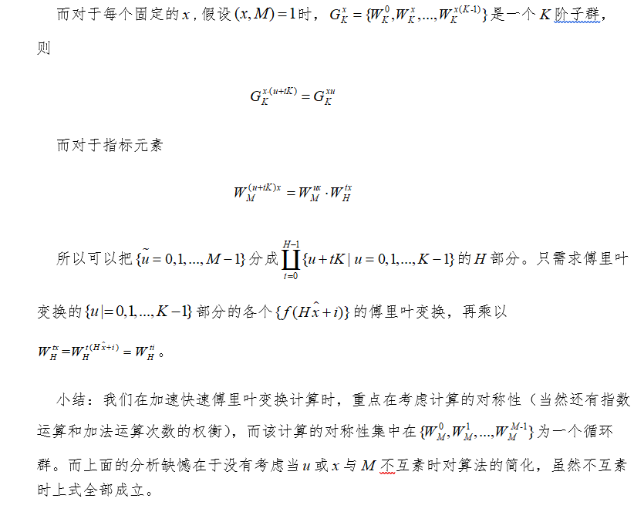
PART2 实验原理
Experimental principle

Slide 9
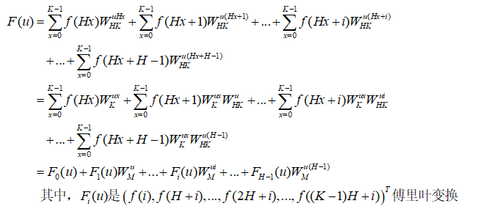
PART2 实验原理
Experimental principle

Slide 10
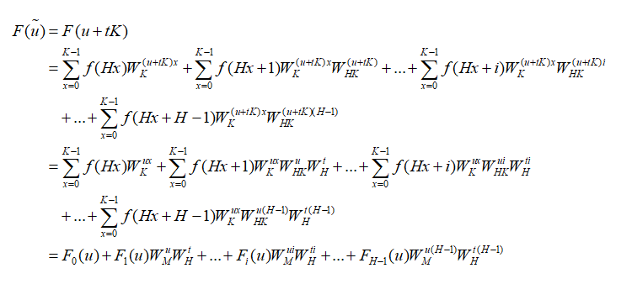
PART2 实验原理
Experimental principle
Lemon drops oat cake oat cake sugar plum. Jelly beans macaroon I love topping danish cake
Lemon drops oat cake oat cake sugar plum. Jelly beans macaroon I love topping danish cake
Lemon drops oat cake oat cake sugar plum. Jelly beans macaroon I love topping danish cake
Lemon drops oat cake oat cake sugar plum. Jelly beans macaroon I love topping danish cake
Lemon drops oat cake oat cake sugar plum. Jelly beans macaroon I love topping danish cake
Lemon drops oat cake oat cake sugar plum. Jelly beans macaroon I love topping danish cake
Lemon drops oat cake oat cake sugar plum. Jelly beans macaroon I love topping danish cake

Slide 11
代码实现
03

Slide 12
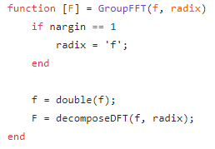


PART3 代码实现
Implementation
XPerview.exe
ETW Consumer
open
WPRUI.exe
ETW Controller
Implement

Slide 13
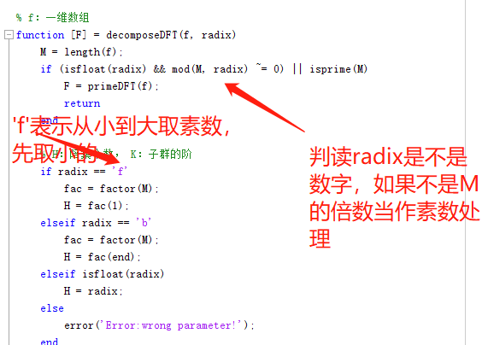
PART3 代码实现
Implementation

Slide 14
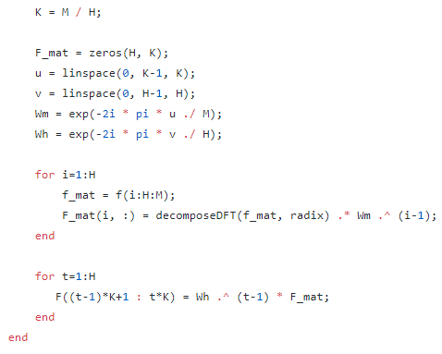
PART3 代码实现
Implementation

Slide 15
效果评估
04

Slide 16
PART4 效果评估
Effect evaluation

Slide 17
PART4 效果评估
Effect evaluation

Slide 18


PART4 效果评估
Effect evaluation

Slide 19
THANK YOU
感谢各位观看

